Slide 2
Capstone Project
Hotel Booking analysis

Slide 3
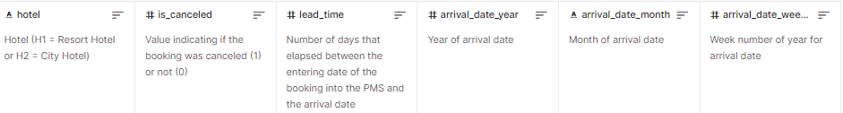
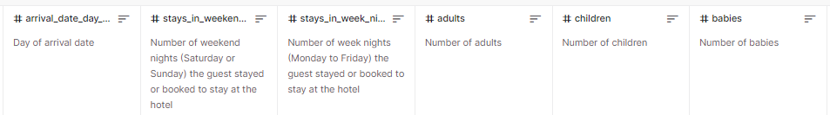
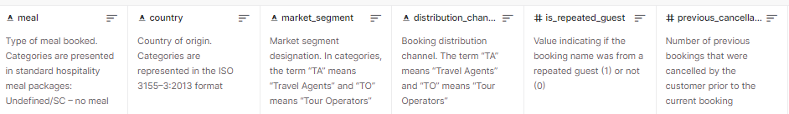
Column introduction :

Slide 4
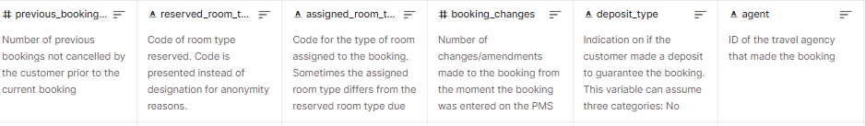
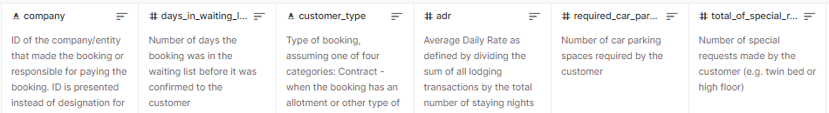
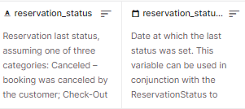

Slide 5
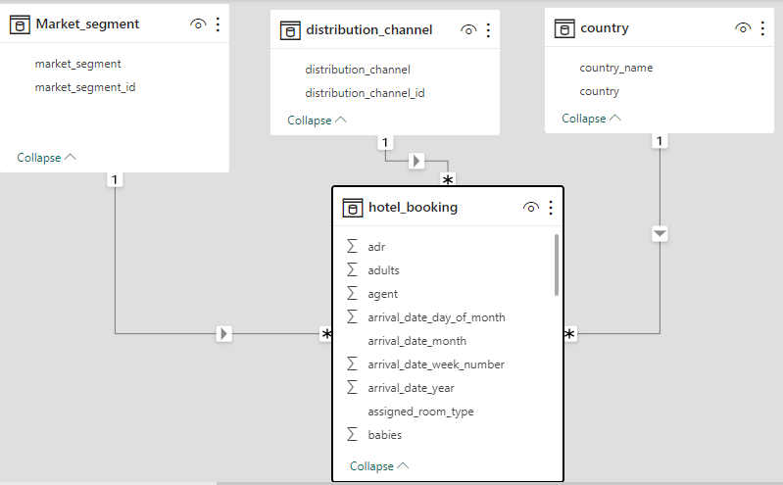
Data Connection :

Slide 6
EDA

Slide 7
EDA Questions :
1.Understand the distribution of arrival dates, including the most common arrival days and summary statistics for lead times.
2.Identify peak booking months and analyze reasons for spikes in bookings, including holidays or events.
3.Calculate the average length of stays for different hotel types and explore variations by meal plans.
4.Analyze how booking patterns have evolved over the years, including yearoveryear changes in bookings and cancellations.
5.Understand the distribution of the number of adults, children, and babies and identify any outliers.
6.Calculate summary statistics for ADR and explore differences between Resort Hotel and City Hotel bookings.
7.Analyze the distribution of required car parking spaces for each hotel type and determine if one type attracts more guests with cars.
8.Compare the total number of special requests made by different customer types (e.g., Transient, Group) and identify which customer type makes more requests.

Slide 8
9.Understand the distribution of meal plans (e.g., BB, HB, FB, SC) and identify any patterns or preferences.
10.Analyze Average Daily Rates (ADR) by meal plan type to identify variations in pricing.
11.Investigate the distribution of required car parking spaces and special requests by hotel type and meal plan. 12 .Compare the distribution of meal plans among different customer types (e.g., Transient, Group) to identify preferences.
12.Understand the distribution of bookings across different market segments and calculate summary statistics for lead times within each segment.
13.Analyze the distribution of bookings through different booking channels (e.g., online travel agents, direct bookings) and calculate the percentage of bookings through each channel.
14.Calculate the proportion of repeated guests and investigate their booking behavior. Identify any patterns or differences in preferences compared to firsttime guests.
15.Explore the impact of a guest's booking history on their likelihood of canceling a current booking. Calculate cancellation rates based on previous cancellations and noncanceled bookings.
16.Understand the distribution of reserved and assigned room types. Calculate summary statistics for the consistency between reserved and assigned room types.

Slide 9
17.Analyze the impact of booking changes on cancellation rates. Calculate cancellation rates for bookings with different numbers of changes.
18.Explore how room type preferences vary across different customer types (e.g., Transient, Group). Identify if certain customer types have specific room preferences.
19.Examine whether guests who make multiple bookings have consistent room type preferences or if their preferences change over time.
20.Understand the distribution of reservation statuses and calculate summary statistics for reservation status dates..
21.Analyze trends in reservation status dates, including the most common checkout dates and any seasonality patterns.
22.Explore how reservation statuses vary across different customer types (e.g., Transient, Group) using Excel or SQL. Calculate cancellation rates by customer type.
23.Investigate whether there are differences in Average Daily Rates (ADR) based on reservation status (e.g., canceled vs. checkedout).

Slide 10
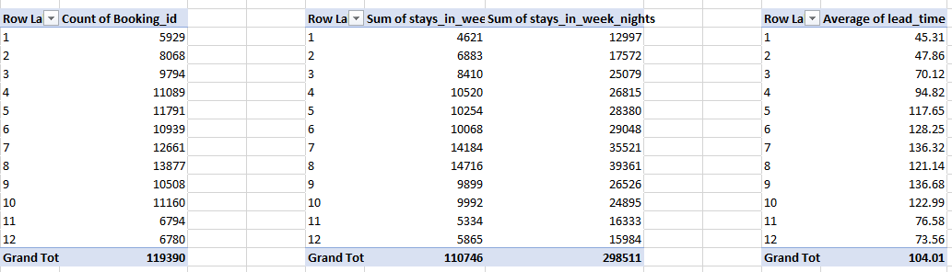
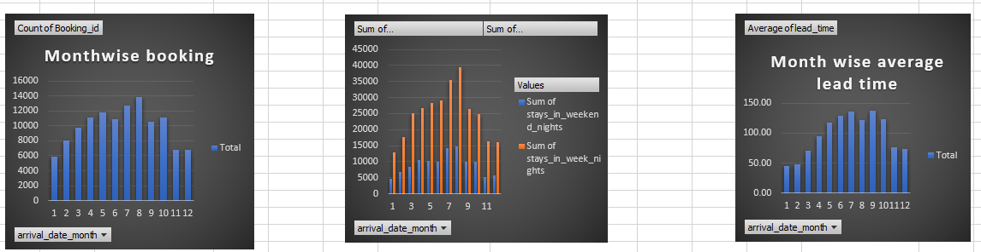
1. From barchart, we conclude that guest gives preference to weekdays nights. And in month of august most of guest arrived at hotel. And in august most of guest gives preference to weekdays only. Average lead time for july and september is maximum and for month of january it is minimum.

Slide 11
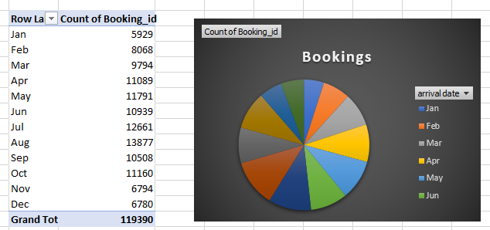
2. We find that for August maximum i.e. 13877 bookings are done. i am unable to give perfect reason behind this maximum bookings done in august as there is no given any event, festival shedule or hotel location. But here I am trying to guess the reason it's may be wrong. One possibility of these maximum bookings for august is that may be in august most holidays or events or festivals are comes. So students, working people get holiday and may be with friends or family they went for picnic.

Slide 12
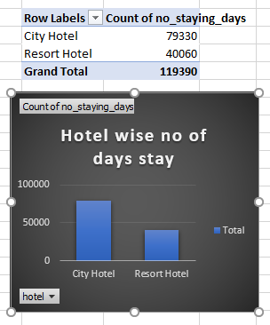
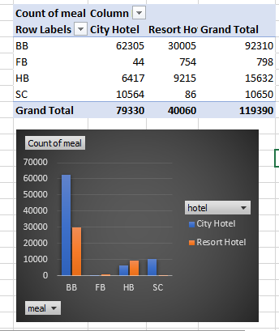
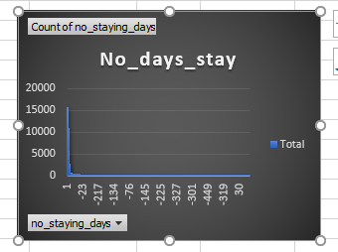
3.We see that BB type meal is most popular. In city hotel meal order maximum compare to resort hotel. In august, both hotels have max order of meal than any other month. In city hotel & resort hotel, FB meal & SC meal has minimum order respectively. Mostly guest gives preference to city hotel for stay. Mostly guest book room for 1 night but avrage of stay is about 9 days. Mostly guest gives preference to august month.

Slide 13
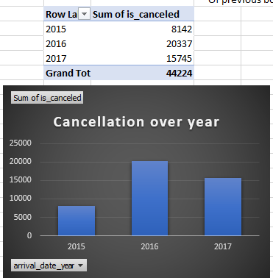
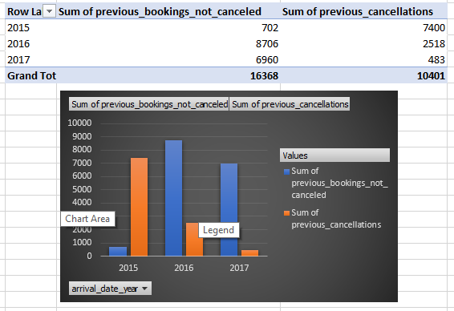
4. In 2016 maximum no. of bookings canceled. For previous booking cancellation 2015 has maximum no. of cancellations and for 2016 maximum no. Of previous bookings not canceled.

Slide 14
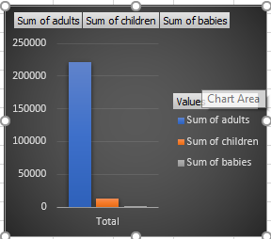
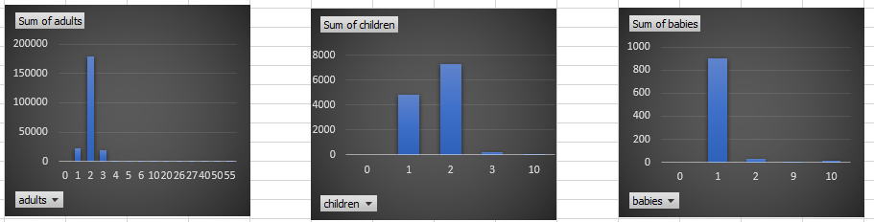
5. Count of adults is maximum than children and babies.
Row Labels | Sum of adults
0 | 0
1 | 23027
2 | 179360
3 | 18606
4 | 248
5 | 10
6 | 6
10 | 10
20 | 40
26 | 130
27 | 54
40 | 40
50 | 50
55 | 55
Grand Total | 221636
Row Labels | Sum of children
0 | 0
1 | 4861
2 | 7304
3 | 228
10 | 10
Grand Total | 12403
Row Labels | Sum of babies
0 | 0
1 | 900
2 | 30
9 | 9
10 | 10
Grand Total | 949
Sum of adults | Sum of children | Sum of babies
221636 | 12403 | 949

Slide 15
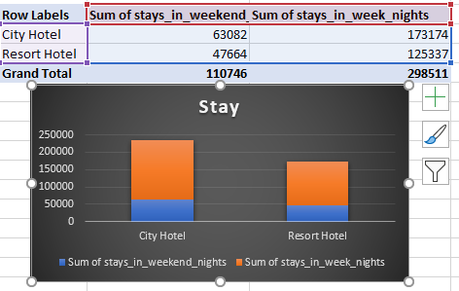
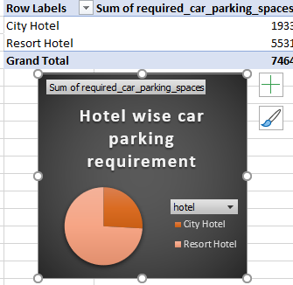
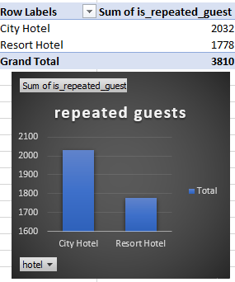
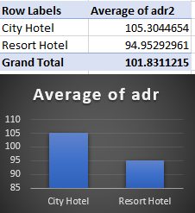

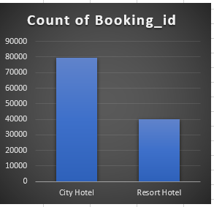
6. Maximum bookings are done in city hotel. Also avg adr, sum of adr of city hotel is greater than resort hotel. Guest repeatedly comes in city hotel campaired to resort hotel.
6. Maximum bookings are done in city hotel. Also avg adr, sum of adr of city hotel is greater than resort hotel. Guest repeatedly comes in city hotel campaired to resort hotel.

Slide 16
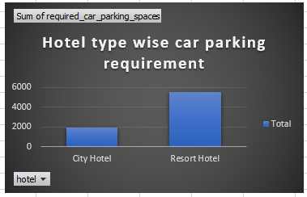

7. Resort hotel required more car parkings than city hotel

Slide 17
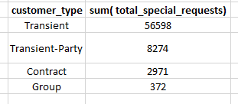
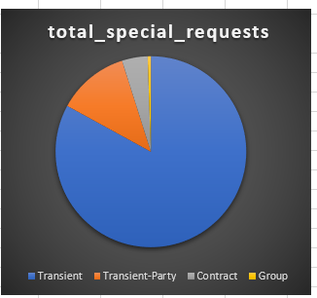
8. Transient Customers made more special requests

Slide 18
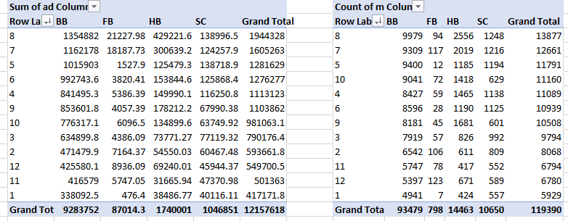
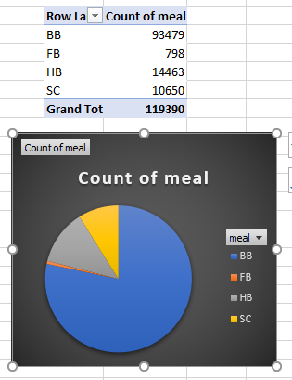
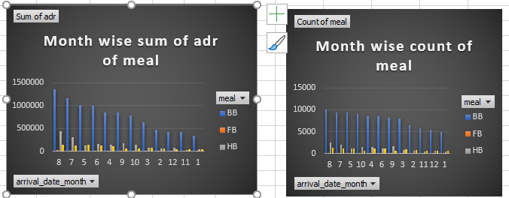
9.BB type of meal is popular meal as its count is maximum & it has a maximum sum of average daily rate. In month of august maximum no. of meal order place & in that orders BB type meal order is maximum.
BB type of is most popular meal as it has maximum no. of count , also it has maximum sum of average daily rate. In august, maximum no. of meal orders is place & in that orders BB type meal orders are maximum.

Slide 19
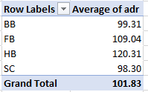
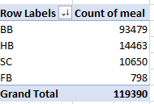
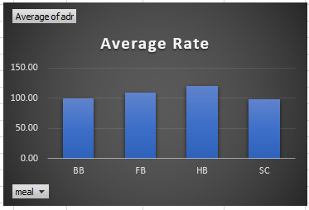
10. Count of BB meals is maximum. It's average rate is about 99.31 which is minimum than any other meal rate. So, it is best, convenient meal plan for everyone.

Slide 20
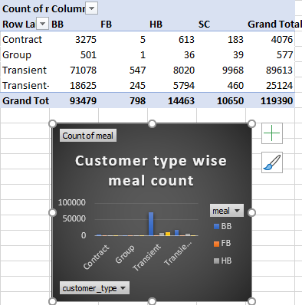
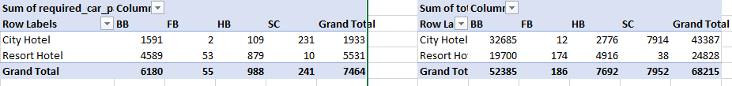
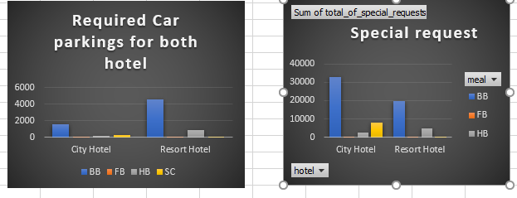
11. we conclude that resort hotel guests required maximum no. of parkings and most of them order BB type of meal. From 2nd chart we get that city hotel's guests who order BB type meal they have maximum no. of special requests. So combinely we can say that city hotel guests who prefered BB type meal they have maximum special requests also they want maximum no. of car parkings.
All 4 types of customerce like contract, group, transient, transient-party give preference to BB type meal. But transient customer order maximum no. of BB meal.

Slide 21
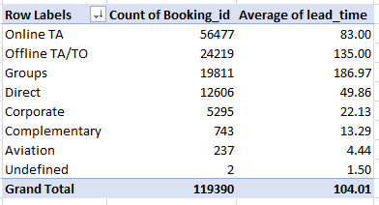
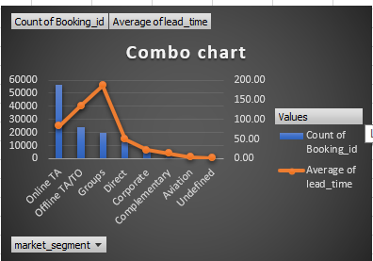
12. From combo chart for maeket segmentwise count of bookings and average lead time, we can see that for market segment Online TA has maximum no. of bookings are done and there average lead time is 83 days. For undefined market segment average lead time is minimum i.e. one and half day & second least average time is 4.44 days for Aviation market segment.

Slide 22
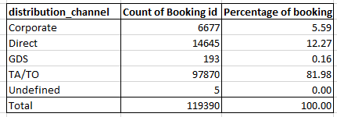
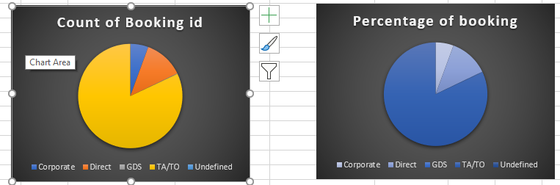
13. For distribution channel TA/TO has maximum percentage of booking. 1st preference is TA/TO channel and second to preference Direct distribution channel.

Slide 23
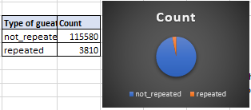
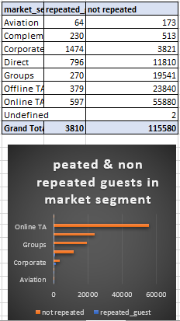
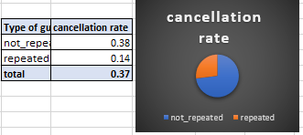
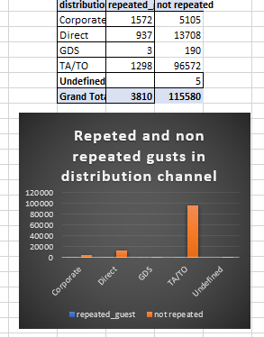
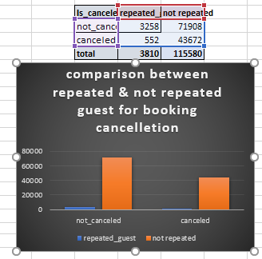
14. Repeated guests are very less i.e. 3810. But cancellation rate is high as compared to count of repeated guest and cancellation rate of norepeated guest. From corporate distribution channel and market segment repeated guests are maximum

Slide 24
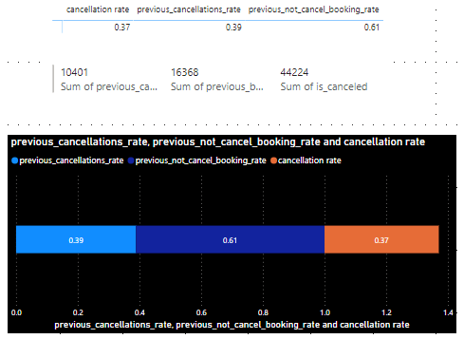
15. Previous cancellation rate is greater than current cancellation booking rate. By calculation current not cancellation rate 0.63 which is greater than previous not cancellation rate.

Slide 25
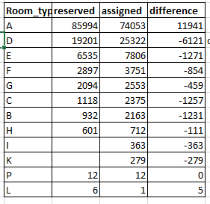
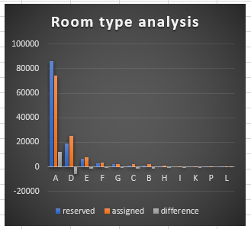
16. Maximum guest reserved A type room and also maximum no. of guest assigned the A type room. So, we can say that A type room was in high demand room type ( may be it's nice and it's cost is affordable ) and they are maximum in no. But also 11941 guest doesn't get there reserved room A. And no one reserved I, K room. 12 guest reserved P room and same no. of P rooms assigned to gust. 6 guest reserved L room but only 1 guest get the L room.

Slide 26
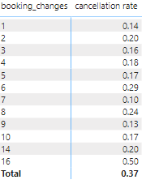
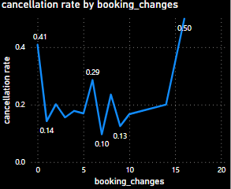
17. As booking changes increses Canccellation rate also increses. That is booking_changes directly proportional to cancellation_rate

Slide 27
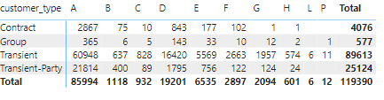
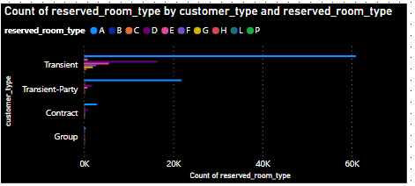
18. Contract, group, transient and transient-party customers mostly prefered the A type room. Contract and transient party not give any preference to L and P rooms. Only 1 preference given by one group customer to P room. And Transient customers reserved 6 L rooms and 11 P rooms. we see that B, C, H, L, P rooms are least preferable rooms.

Slide 28

19. only through 6 booking id more than one booking i.e. 2 bookings are done. All of thry give preference for BB meal for atleat 1 people and for other one they give preference to HB or Sc meal otherwise they give preference to BB meal for both bookings.

Slide 29


20. Most off the guest status is checkout

Slide 30



21. In 2016 maximum cancellation done and in 2014 all 181 bookings was canceled. Maximum checkout done in 2016 and least checkout in 2015.
In oct 2016 maximum check out done then in may 2017 3575 checkout done and in oct 2015 minimum 3304 checkout done

Slide 31


22. cancellation rate of transient customer is high. For transient Check-out count is maximum. Count of no show status is negligible for contract, group and transient-party customer type.

Slide 32

23. Yes, average daily rate changes as per reservation status. For check-out status sum of adr is maximum and for canceled status average of adr is maximum.

Slide 33
Power BI

Slide 34
Power Bi questions :
Visualize booking trends over the years, including the number of bookings, cancellations, and average lead time. Identify seasonality patterns.
2. Analyze monthly booking patterns to identify peak months and optimize marketing strategies.
3. Compare stays in weekend nights and weekday nights to determine preferences and variations by hotel type.
4. Calculate and visualize the booking conversion rate (canceled bookings to total bookings) over time.
5. Visualize the distribution of adults, children, and babies in bookings. Explore the impact of children and babies on cancellation rates.
6. Analyze the distribution of Average Daily Rates (ADR) and identify correlations with the number of special requests made by guests.

Slide 35
7. Visualize the relationship between the number of required car parking spaces and booking types (Resort Hotel vs. City Hotel).
8. Use Power BI to explore how the total number of special requests made by guests varies by hotel type and customer type (e.g., Transient, Group).
9. Explore meal plans and their impact on Average Daily Rates (ADR). Analyze meal plan preferences and their association with booking channels.
10. Analyze how meal plans correlate with stay duration and investigate any differences in stay lengths based on meal plans.
11. Correlate parking requirements and special requests with different meal plans. Determine if certain meal plans result in more requests or parking needs.
12. Explore how meal plans are distributed across various booking channels. Analyze if certain channels are associated with specific meal plans.
13. Visualize booking distribution across different market segments and analyze cancellation rates within each segment.

Slide 36
14. Compare the effectiveness of booking distribution channels in generating confirmed bookings. Identify the most commonly used channels by guests.
15. Visualize the percentage of repeated guests for each hotel type (Resort Hotel vs. City Hotel) over time. Explore factors influencing guest retention.
16. Analyze the impact of a guest's booking history (previous cancellations and noncanceled bookings) on their likelihood of canceling a current booking.
17. Visualize the distribution of reserved and assigned room types. Analyze whether guests tend to receive the room type they initially reserved.
18. Investigate the relationship between the number of booking changes made by guests and their likelihood of canceling a booking.
19. Analyze room type preferences based on customer types (e.g., Transient, Group) and identify any patterns in room type selection.
20. Analyze whether guests who make multiple bookings tend to consistently request the same room type or if their preferences change over time.

Slide 37
21. Provide an overview of reservation statuses over time, including the percentage of canceled, checked-out, and no show bookings.
22. Analyze trends in reservation status dates, such as the busiest checkout dates or patterns in cancellations by month.
23. Visualize how reservation statuses vary across different customer types (e.g., Transient, Group) and identify if certain customer types are more likely to result in cancellations or noshow.
24. Explore the relationship between reservation statuses and Average Daily Rates (ADR) to determine if there are differences in ADR based on booking outcomes.

Slide 38

1.

Slide 39

2.

Slide 40

3.

Slide 41

4.

Slide 42

5.

Slide 43

6.

Slide 44

7.

Slide 45

8.

Slide 46

9.

Slide 47
10.

Slide 48

11.

Slide 49

12.

Slide 50

13.

Slide 51

14.

Slide 52

15.

Slide 53

16.

Slide 54

17.

Slide 55

18.

Slide 56

19.

Slide 57

20.

Slide 58

21.

Slide 59

22.

Slide 60

23.

Slide 61

24.

